Slide 1
实验数据记录表---路径损失模型拟合参数表
依安装位置分为，宽棱中点，竖棱中点以及顶角。
使用的拟合模型，按照LOS以及NLOS的情况分为两类

Slide 2
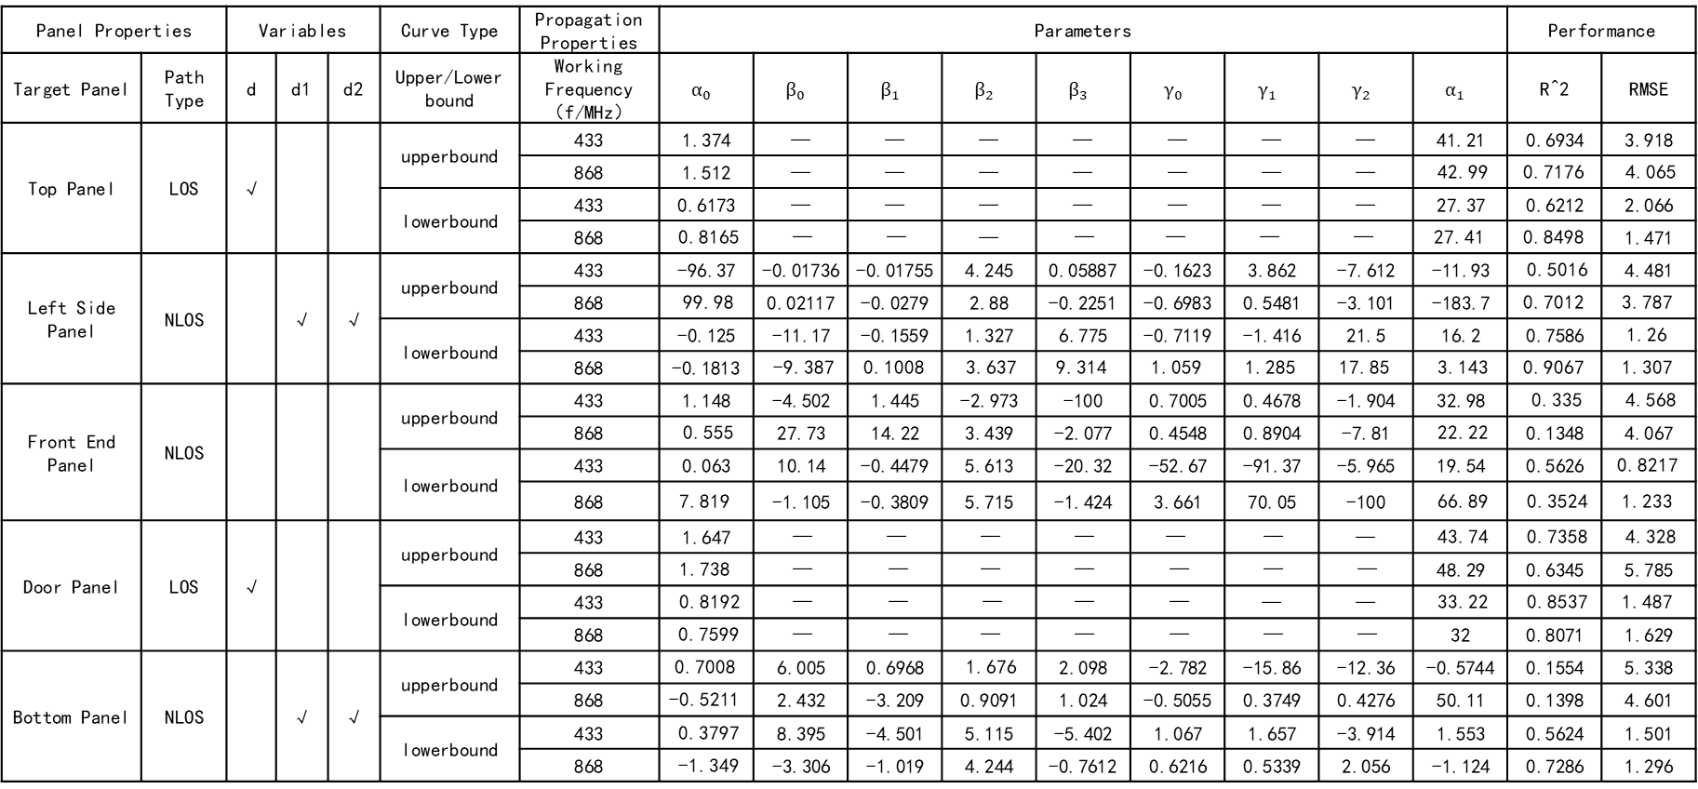
宽棱中点
Panel Properties |  | Variables |  |  | Curve Type | Propagation Properties | Parameters |  |  |  |  |  |  |  |  | Performance
Target Panel | Path Type | d | d1 | d2 | Upper/Lower bound | Working Frequency（f/MHz） | $$α_{0}$$ | $$β_{0}$$ | $$β_{1}$$ | $$β_{2}$$ | $$β_{3}$$ | $$γ_{0}$$ | $$γ_{1}$$ | $$γ_{2}$$ | $$α_{1}$$ | R^2 | RMSE
Top Panel | LOS | √ |  |  | upperbound | 433 | 1.374 | — | — | — | — | — | — | — | 41.21 | 0.6934 | 3.918
 |  |  |  |  |  | 868 | 1.512 | — | — | — | — | — | — | — | 42.99 | 0.7176 | 4.065
 |  |  |  |  | lowerbound | 433 | 0.6173 | — | — | — | — | — | — | — | 27.37 | 0.6212 | 2.066
 |  |  |  |  |  | 868 | 0.8165 | — | — | — | — | — | — | — | 27.41 | 0.8498 | 1.471
Left Side Panel | NLOS |  | √ | √ | upperbound | 433 | -96.37 | -0.01736 | -0.01755 | 4.245 | 0.05887 | -0.1623 | 3.862 | -7.612 | -11.93 | 0.5016 | 4.481
 |  |  |  |  |  | 868 | 99.98 | 0.02117 | -0.0279 | 2.88 | -0.2251 | -0.6983 | 0.5481 | -3.101 | -183.7 | 0.7012 | 3.787
 |  |  |  |  | lowerbound | 433 | -0.125 | -11.17 | -0.1559 | 1.327 | 6.775 | -0.7119 | -1.416 | 21.5 | 16.2 | 0.7586 | 1.26
 |  |  |  |  |  | 868 | -0.1813 | -9.387 | 0.1008 | 3.637 | 9.314 | 1.059 | 1.285 | 17.85 | 3.143 | 0.9067 | 1.307
Front End Panel | NLOS |  |  |  | upperbound | 433 | 1.148 | -4.502 | 1.445 | -2.973 | -100 | 0.7005 | 0.4678 | -1.904 | 32.98 | 0.335 | 4.568
 |  |  |  |  |  | 868 | 0.555 | 27.73 | 14.22 | 3.439 | -2.077 | 0.4548 | 0.8904 | -7.81 | 22.22 | 0.1348 | 4.067
 |  |  |  |  | lowerbound | 433 | 0.063 | 10.14 | -0.4479 | 5.613 | -20.32 | -52.67 | -91.37 | -5.965 | 19.54 | 0.5626 | 0.8217
 |  |  |  |  |  | 868 | 7.819 | -1.105 | -0.3809 | 5.715 | -1.424 | 3.661 | 70.05 | -100 | 66.89 | 0.3524 | 1.233
Door Panel | LOS | √ |  |  | upperbound | 433 | 1.647 | — | — | — | — | — | — | — | 43.74 | 0.7358 | 4.328
 |  |  |  |  |  | 868 | 1.738 | — | — | — | — | — | — | — | 48.29 | 0.6345 | 5.785
 |  |  |  |  | lowerbound | 433 | 0.8192 | — | — | — | — | — | — | — | 33.22 | 0.8537 | 1.487
 |  |  |  |  |  | 868 | 0.7599 | — | — | — | — | — | — | — | 32 | 0.8071 | 1.629
Bottom Panel | NLOS |  | √ | √ | upperbound | 433 | 0.7008 | 6.005 | 0.6968 | 1.676 | 2.098 | -2.782 | -15.86 | -12.36 | -0.5744 | 0.1554 | 5.338
 |  |  |  |  |  | 868 | -0.5211 | 2.432 | -3.209 | 0.9091 | 1.024 | -0.5055 | 0.3749 | 0.4276 | 50.11 | 0.1398 | 4.601
 |  |  |  |  | lowerbound | 433 | 0.3797 | 8.395 | -4.501 | 5.115 | -5.402 | 1.067 | 1.657 | -3.914 | 1.553 | 0.5624 | 1.501
 |  |  |  |  |  | 868 | -1.349 | -3.306 | -1.019 | 4.244 | -0.7612 | 0.6216 | 0.5339 | 2.056 | -1.124 | 0.7286 | 1.296

Slide 3
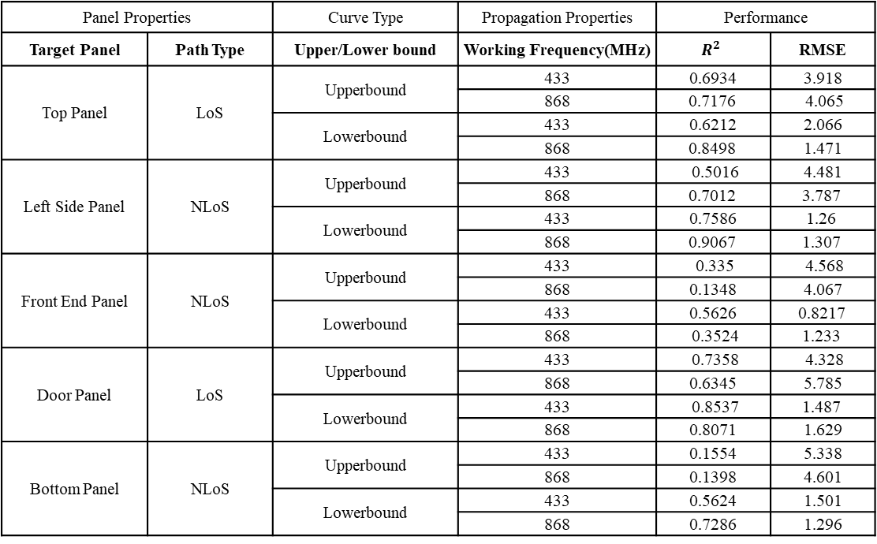
Panel Properties |  | Curve Type | Propagation Properties | Performance
Target Panel | Path Type | Upper/Lower bound | Working Frequency(MHz) | $$R^{2}$$ | RMSE
Top Panel | LoS | Upperbound | 433 | 0.6934 | 3.918
 |  |  | 868 | 0.7176 | 4.065
 |  | Lowerbound | 433 | 0.6212 | 2.066
 |  |  | 868 | 0.8498 | 1.471
Left Side Panel | NLoS | Upperbound | 433 | 0.5016 | 4.481
 |  |  | 868 | 0.7012 | 3.787
 |  | Lowerbound | 433 | 0.7586 | 1.26
 |  |  | 868 | 0.9067 | 1.307
Front End Panel | NLoS | Upperbound | 433 | 0.335 | 4.568
 |  |  | 868 | 0.1348 | 4.067
 |  | Lowerbound | 433 | 0.5626 | 0.8217
 |  | Upperbound | 868 | 0.3524 | 1.233
Door Panel | LoS | Upperbound | 433 | 0.7358 | 4.328
 |  |  | 868 | 0.6345 | 5.785
 |  | Lowerbound | 433 | 0.8537 | 1.487
 |  |  | 868 | 0.8071 | 1.629
Bottom Panel | NLoS | Upperbound | 433 | 0.1554 | 5.338
 |  |  | 868 | 0.1398 | 4.601
 |  | Lowerbound | 433 | 0.5624 | 1.501
 |  |  | 868 | 0.7286 | 1.296

Slide 4
顶角
表面属性 |  | 因变量 |  |  | 目标曲线 | 定量 | 参数 |  |  |  |  |  |  |  |  | 拟合性能
目标表面 | 路径特点 | d | d1 | d2 | 上界/下界 | 工作频率（f/MHz） | a | b | c | d | e | f | g | h | k | R^2 | RMSE
顶面 | LOS | √ |  |  | 上界 | 433 | 1.68 | 32.31 | — | — | — | — | — | — | — | 0.7886 | 3.657
 |  |  |  |  |  | 868 | 1.807 | 33.59 | — | — | — | — | — | — | — | 0.8349 | 3.379
 |  |  |  |  | 下界 | 433 | 0.8167 | 19.38 | — | — | — | — | — | — | — | 0.7905 | 1.768
 |  |  |  |  |  | 868 | 0.8951 | 21.24 | — | — | — | — | — | — | — | 0.9446 | 0.9111
左侧面 | NLOS |  | √ | √ | 上界 | 433 | 1.234 | 9.07 | 0.5496 | 0.1436 | 4.639 | 0.2458 | 0.3931 | -4.311 | 6.492 | 0.5445 | 3.553
 |  |  |  |  |  | 868 | 1.286 | 9.182 | 0.6328 | 0.4113 | 4.324 | 0.327 | 0.06242 | -4.332 | 0.2717 | 0.6558 | 3.609
 |  |  |  |  | 下界 | 433 | -1.092 | -4.806 | 0.006676 | 1.05 | -6.095 | -0.03005 | -0.06018 | 2.31 | 8.17 | 0.8749 | 1.182
 |  |  |  |  |  | 868 | 6.654 | .0..00808 | -0.06992 | 0.8456 | -0.7751 | -0.05944 | 3.855 | -7.098 | -17.78 | 0.8208 | 1.361
前端面 | NLOS |  |  |  | 上界 | 433 | 6.782 | 1.365 | -0.1848 | 1.785 | 4.761 | -0.2458 | 1.778 | -0.7279 | 223.7 | 0.2881 | 3.598
 |  |  |  |  |  | 868 | 9.261 | -28.49 | -0.007491 | -1.195 | -55.4 | 0.01162 | -0.02242 | -0.5811 | -0.2261 | 0.3494 | 3.435
 |  |  |  |  | 下界 | 433 | -0.1337 | -236 | 0.1529 | 0.9647 | -380 | -1.533 | -2.3 | 68.38 | -55.54 | 0.7009 | 1.096
 |  |  |  |  |  | 868 | -0.09603 | 2.098 | 6.909 | 1.256 | -74.22 | -1.345 | -3.063 | -11.51 | 50.33 | 0.2923 | 0.8515
右侧面 | LOS | √ |  |  | 上界 | 433 | 1.976 | 44.03 | — | — | — | — | — | — | — | 0.7171 | 5.291
 |  |  |  |  |  | 868 | 1.586 | 47.16 | — | — | — | — | — | — | — | 0.6155 | 5.343
 |  |  |  |  | 下界 | 433 | 0.4929 | 34.08 | — | — | — | — | — | — | — | 0.5676 | 1.834
 |  |  |  |  |  | 868 | 1.037 | 34.48 | — | — | — | — | — | — | — | 0.8552 | 1.819
门板面 | LOS | √ |  |  | 上界 | 433 | 1.756 | 33.2 | — | — | — | — | — | — | — | 0.7752 | 3.94
 |  |  |  |  |  | 868 | 2.177 | 37.73 | — | — | — | — | — | — | — | 0.808 | 4.421
 |  |  |  |  | 下界 | 433 | 0.7672 | 23.08 | — | — | — | — | — | — | — | 0.8269 | 1.462
 |  |  |  |  |  | 868 | 1.138 | 24.77 | — | — | — | — | — | — | — | 0.6044 | 3.836
底面 | NLOS |  | √ | √ | 上界 | 433 | 0.05937 | 53.76 | 1.939 | -0.0091 | -0.8594 | 20.53 | 24.44 | -83.83 | 9.396 | 0.5054 | 3.776
 |  |  |  |  |  | 868 | -0.08513 | -42.55 | -1.886 | 0.007366 | 44.75 | 14.61 | 99.99 | -46.2 | -16.86 | 0.2744 | 3.735
 |  |  |  |  | 下界 | 433 | 0.1457 | -122.7 | -2.964 | -1.348 | -94.16 | 2.047 | 3.548 | 45.29 | 100 | 0.5951 | 1.262
 |  |  |  |  |  | 868 | -5.071 | 0.2992 | -0.5355 | 0.7321 | 1.144 | -0.1227 | 2.415 | -3.034 | -1.742 | 0.8557 | 1.106

Slide 5
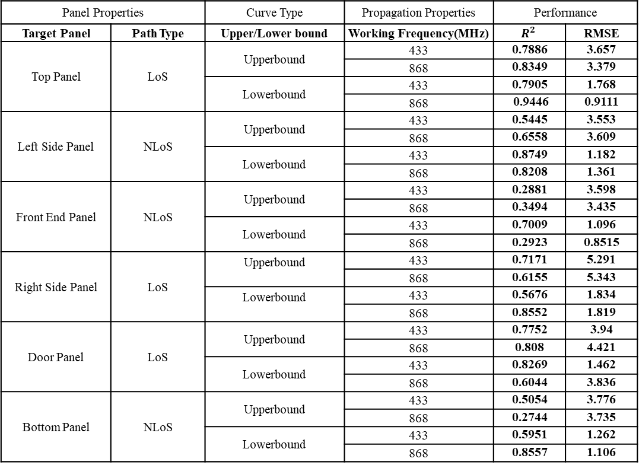
Panel Properties |  | Curve Type | Propagation Properties | Performance
Target Panel | Path Type | Upper/Lower bound | Working Frequency(MHz) | $$R^{2}$$ | RMSE
Top Panel | LoS | Upperbound | 433 | 0.7886 | 3.657
 |  |  | 868 | 0.8349 | 3.379
 |  | Lowerbound | 433 | 0.7905 | 1.768
 |  |  | 868 | 0.9446 | 0.9111
Left Side Panel | NLoS | Upperbound | 433 | 0.5445 | 3.553
 |  |  | 868 | 0.6558 | 3.609
 |  | Lowerbound | 433 | 0.8749 | 1.182
 |  |  | 868 | 0.8208 | 1.361
Front End Panel | NLoS | Upperbound | 433 | 0.2881 | 3.598
 |  |  | 868 | 0.3494 | 3.435
 |  | Lowerbound | 433 | 0.7009 | 1.096
 |  | Upperbound | 868 | 0.2923 | 0.8515
Right Side Panel | LoS | Upperbound | 433 | 0.7171 | 5.291
 |  |  | 868 | 0.6155 | 5.343
 |  | Lowerbound | 433 | 0.5676 | 1.834
 |  |  | 868 | 0.8552 | 1.819
Door Panel | LoS | Upperbound | 433 | 0.7752 | 3.94
 |  |  | 868 | 0.808 | 4.421
 |  | Lowerbound | 433 | 0.8269 | 1.462
 |  |  | 868 | 0.6044 | 3.836
Bottom Panel | NLoS | Upperbound | 433 | 0.5054 | 3.776
 |  |  | 868 | 0.2744 | 3.735
 |  | Lowerbound | 433 | 0.5951 | 1.262
 |  |  | 868 | 0.8557 | 1.106

Slide 6
高边中点
表面属性 |  | 因变量 |  |  | 目标曲线 | 定量 | 参数 |  |  |  |  |  |  |  |  | 拟合性能
目标表面 | 路径特点 | d | d1 | d2 | 上界/下界 | 工作频率（f/MHz） | a | b | c | d | e | f | g | h | k | R^2 | RMSE
顶面 | NLOS |  | √ | √ | 上界 | 433 | -8.111 | -0.2436 | -0.04342 | 0.6755 | 2.312 | -0.1974 | 1.666 | -0.6873 | -150.6 | 0.5534 | 4.54
 |  |  |  |  |  | 868 | 20.85 | 1.803 | 0.2845 | 0.3307 | -1.096 | 0.02894 | 0.02689 | -0.3049 | -0.2328 | 0.48 | 3.878
 |  |  |  |  | 下界 | 433 | 1.774 | 0.1871 | -0.09745 | 1.928 | -1.631 | -2.383 | -8.252 | -5.615 | 4.416 | 0.8529 | 1.596
 |  |  |  |  |  | 868 | 0.1069 | 4.176 | -0.5094 | 1.537 | -7.611 | 14 | 18.96 | -39.26 | 24.86 | 0.8417 | 1.263
左侧面 | NLOS |  | √ | √ | 上界 | 433 | -0.699 | -199 | -3.825 | -1.646 | -233.4 | -0.3564 | -0.3564 | 15.98 | -58.6 | 0.2031 | 4.844
 |  |  |  |  |  | 868 | 0.02246 | 96.47 | 1.485 | 0.8372 | -41.1 | -86.14 | -254.7 | 50.84 | 15.98 | 0.4206 | 4.597
 |  |  |  |  | 下界 | 433 | -0.009471 | -80.47 | 0.7578 | 81.03 | -22 23 | 34.76 | 54.07 | 43.57 | 26.43 | 0.5527 | 1.247
 |  |  |  |  |  | 868 | -0.08735 | -100 | -6.282 | 0.9608 | -57.19 | -0.4375 | 0.384 | 63.01 | -21.72 | 0.4542 | 1.22
前端面 | NLOS |  | √ | √ | 上界 | 433 | 1.025 | -44.1 | -1.554 | 1.264 | -71.37 | -64.03 | -113.1 | 34.94 | 46.42 | 0.2807 | 4.312
 |  |  |  |  |  | 868 | 19.1 | -60.59 | -0.2214 | -3.509 | -99.02 | -0.04974 | -0.09606 | -0.3029 | -4.192 | 0.2989 | 4.352
 |  |  |  |  | 下界 | 433 | 0.03232 | 65.03 | 1.16 | -0.3694 | 32.4 | 39.12 | 38.85 | -68.94 | 24.34 | 0.5142 | 1.494
 |  |  |  |  |  | 868 | -2.357 | -4.145 | -0.09368 | 0.712 | -5.329 | 69.27 | 88.06 | -43.53 | 11.06 | 0.5006 | 1.302
右侧面 | LOS | √ |  |  | 上界 | 433 | 1.746 | 46.3 | — | — | — | — | — | — | — | 0.7052 | 4.837
 |  |  |  |  |  | 868 | 1.832 | 43.92 | — | — | — | — | — | — | — | 0.7023 | 5.112
 |  |  |  |  | 下界 | 433 | 1.04 | 33.72 | — | — | — | — | — | — | — | 0.8379 | 1.959
 |  |  |  |  |  | 868 | 0.7966 | 32.61 | — | — | — | — | — | — | — | 0.8832 | 1.242
门板面 | LOS | √ |  |  | 上界 | 433 | 1.913 | 38.22 | — | — | — | — | — | — | — | 0.7256 | 4.933
 |  |  |  |  |  | 868 | 1.425 | 36.4 | — | — | — | — | — | — | — | 0.613 | 4.746
 |  |  |  |  | 下界 | 433 | 0.8239 | 24.8 | — | — | — | — | — | — | — | 0.8958 | 1.178
 |  |  |  |  |  | 868 | 0.9441 | 25.15 | — | — | — | — | — | — | — | 0.9021 | 1.304

Slide 7
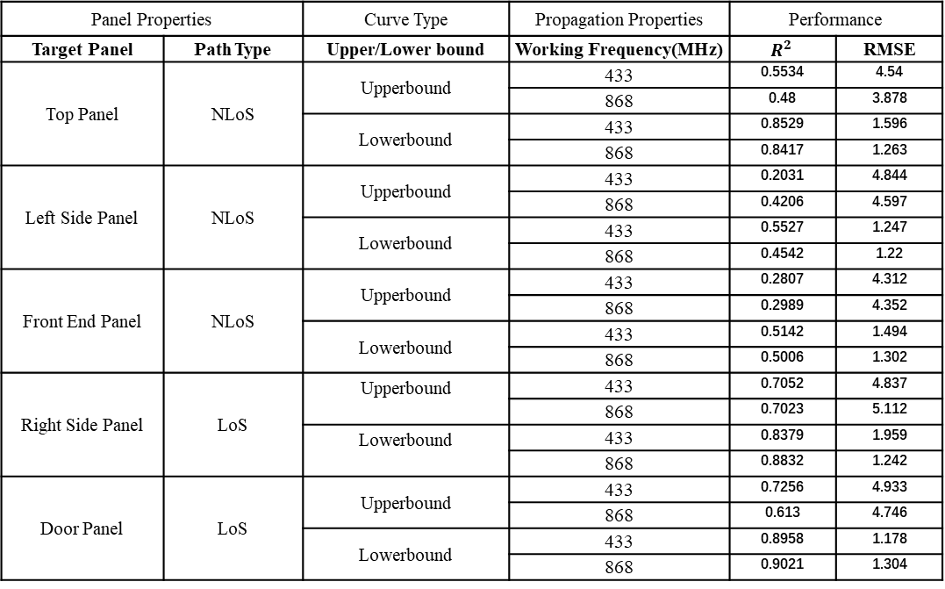
Panel Properties |  | Curve Type | Propagation Properties | Performance
Target Panel | Path Type | Upper/Lower bound | Working Frequency(MHz) | $$R^{2}$$ | RMSE
Top Panel | NLoS | Upperbound | 433 | 0.5534 | 4.54
 |  |  | 868 | 0.48 | 3.878
 |  | Lowerbound | 433 | 0.8529 | 1.596
 |  |  | 868 | 0.8417 | 1.263
Left Side Panel | NLoS | Upperbound | 433 | 0.2031 | 4.844
 |  |  | 868 | 0.4206 | 4.597
 |  | Lowerbound | 433 | 0.5527 | 1.247
 |  |  | 868 | 0.4542 | 1.22
Front End Panel | NLoS | Upperbound | 433 | 0.2807 | 4.312
 |  |  | 868 | 0.2989 | 4.352
 |  | Lowerbound | 433 | 0.5142 | 1.494
 |  | Upperbound | 868 | 0.5006 | 1.302
Right Side Panel | LoS | Upperbound | 433 | 0.7052 | 4.837
 |  |  | 868 | 0.7023 | 5.112
 |  | Lowerbound | 433 | 0.8379 | 1.959
 |  |  | 868 | 0.8832 | 1.242
Door Panel | LoS | Upperbound | 433 | 0.7256 | 4.933
 |  |  | 868 | 0.613 | 4.746
 |  | Lowerbound | 433 | 0.8958 | 1.178
 |  |  | 868 | 0.9021 | 1.304

